Slide 1
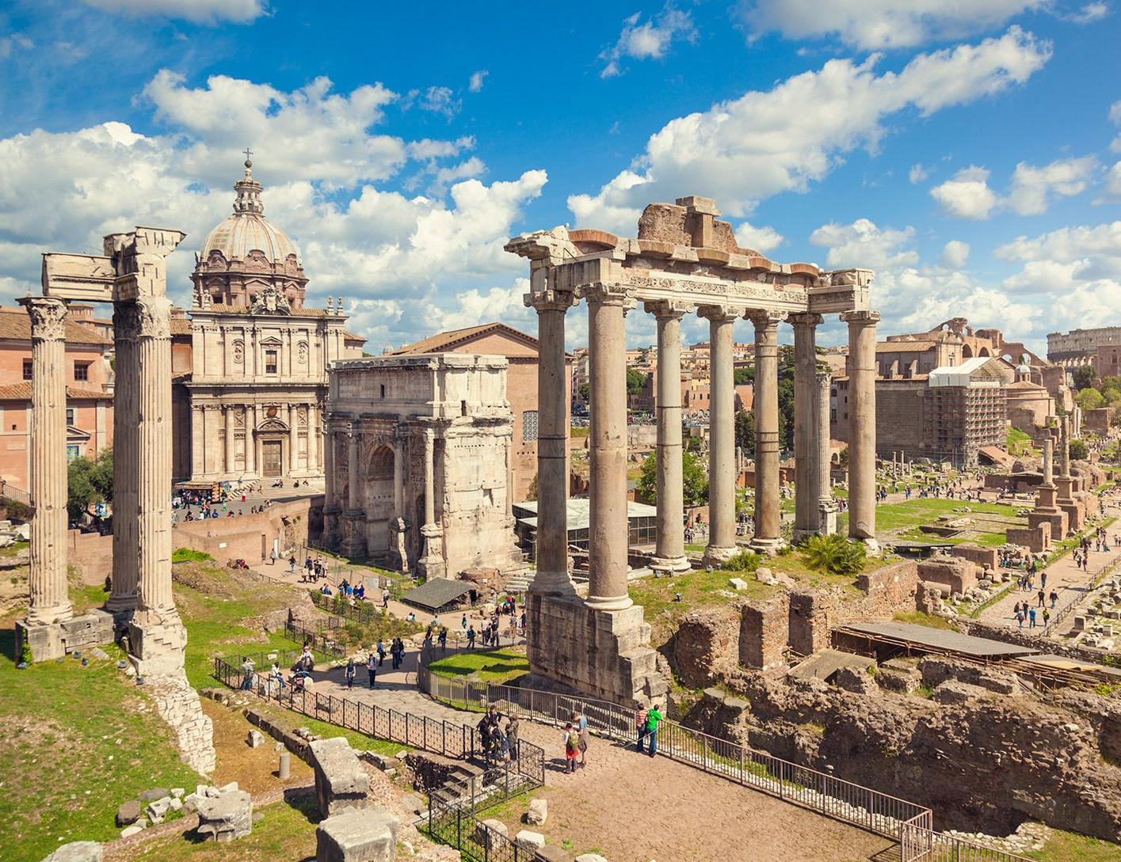
Power in Ancient Rome
- Define and describe key terms
- Explain how people could gain power in Ancient Rome
Week 5 Lesson 3
Ms Barrie

Slide 2
Roman Government - Review
https://www.youtube.com/watch?v=Kpb1ioOYRHc&ab_channel=KhAnubis

Slide 3
Authority in ancient Rome was complex, and as one can expect from Rome, full of tradition, myth, and awareness of their own storied history. Perhaps the ultimate authority was imperium, the power to command the Roman army. Potestas was legal power belonging to the various roles of political offices. There was also auctoritas, a kind of intangible social authority tied to reputation and status. In the everyday Roman household, the absolute authority was the father, known as the paterfamilias. Today we will examine these various types of authority which spanned across centuries and covered all facets of Roman life - from the household to public politics to the battlefield.

Slide 4
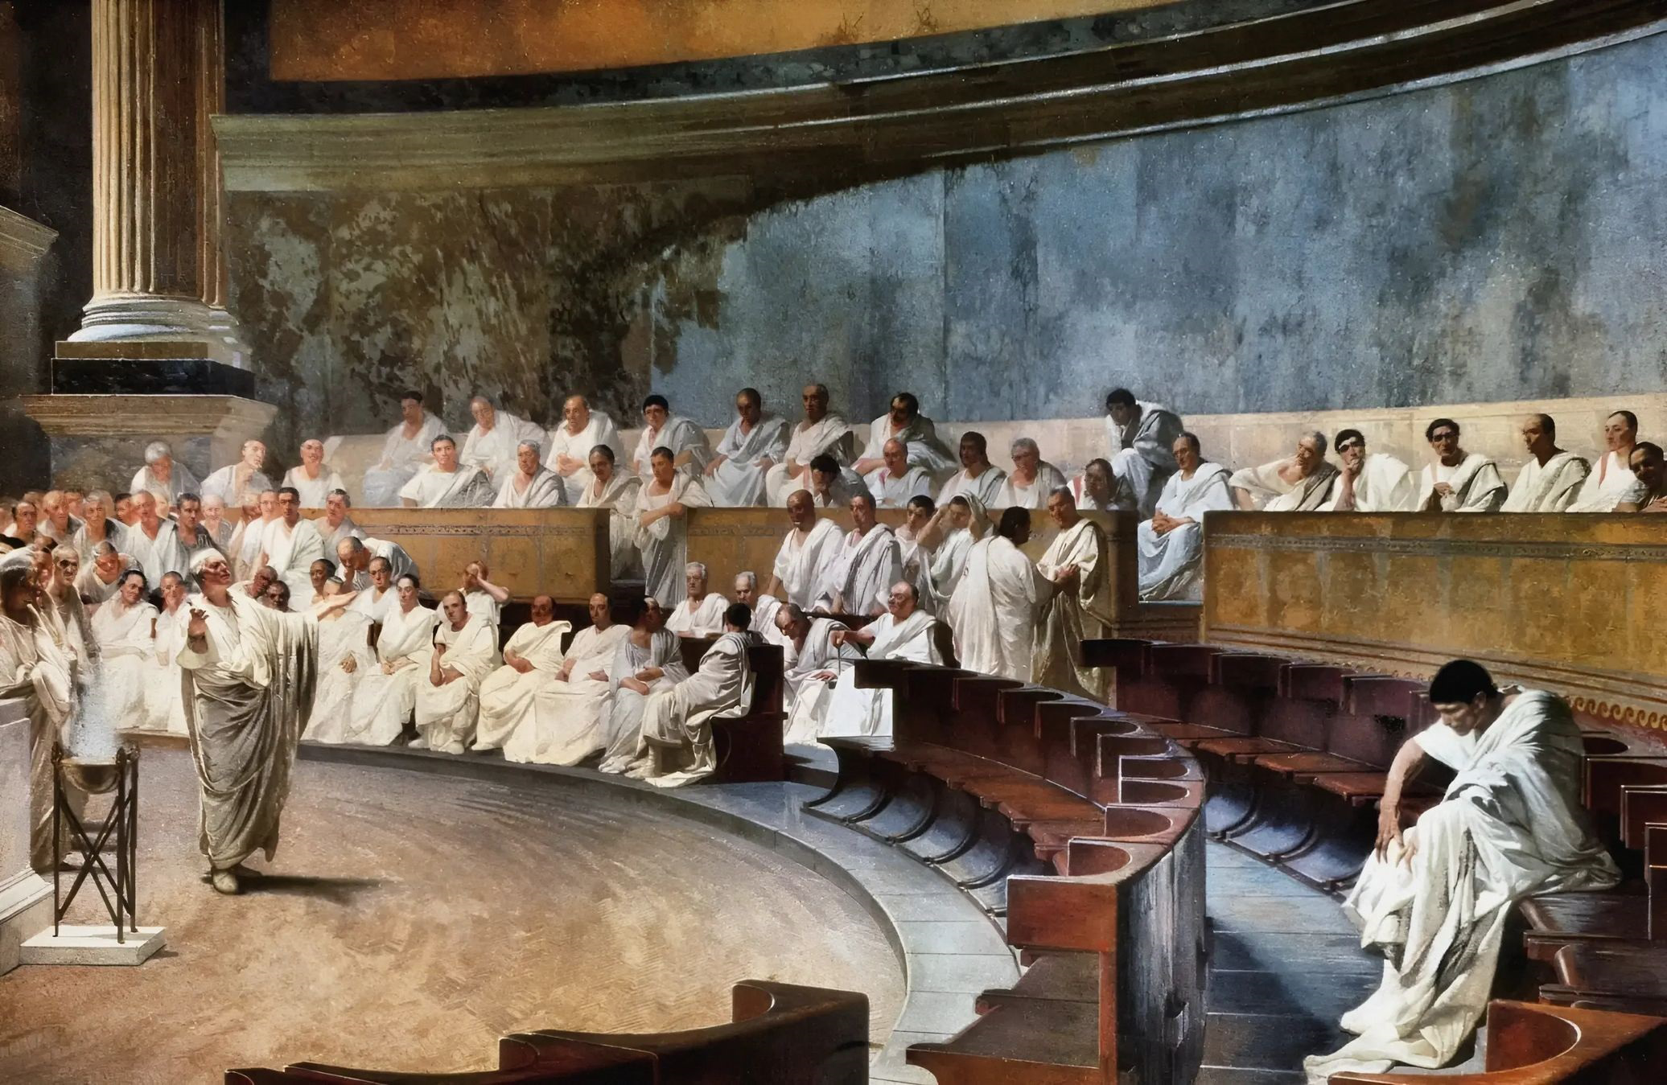
Auctoritas
DEFINITION:
Social authority, reputation, and status
Write this in your book

Slide 5
Auctoritas
intangible prestige
Partly earned, partly inherent
Earned by valour and braveness in battlefield
IMPERATOR or ‘victorious commander’
prestigious political positions
Noble bloodline

Slide 6
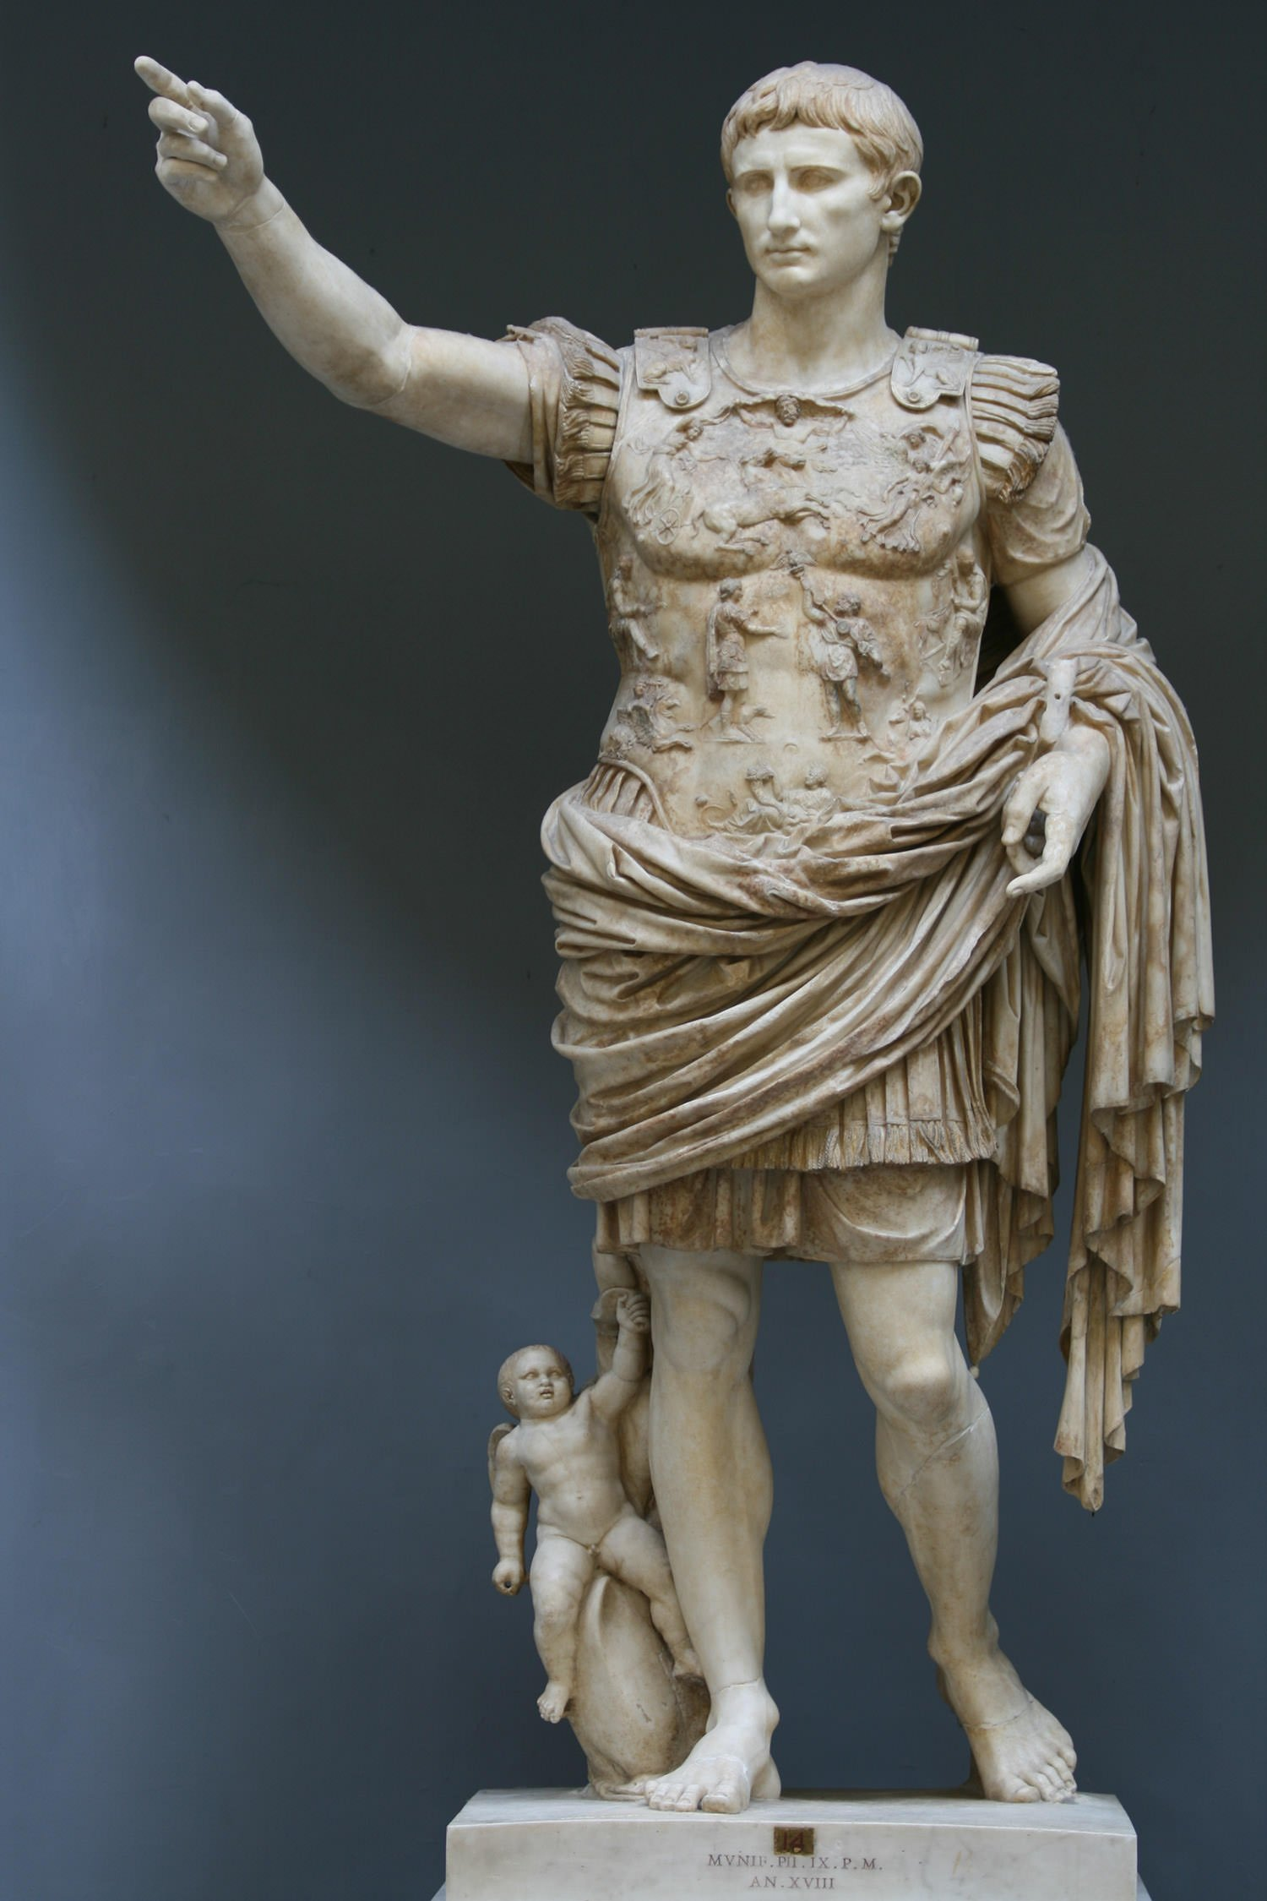
Imperium
DEFINITION:
Authority held by magistrates to command the roman army
Write this in your book

Slide 7
Imperium
Supreme form of legal power
Consuls, Praetors, Proconsuls
Formal or delegated
A ”God-Given” right
Could not be held IN the boundaries of Rome (Pomerium) – seen as declaration of power/war

Slide 8
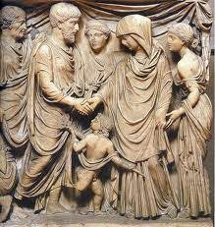
Potestas
DEFINITION:
Legal authority of a political office
Write this in your book

Slide 9
Potestas
Defined by law
3 most important political offices
consul – propose laws, senate, military command (2)
praetor – elected by popular assembly, judges
tribune – plebian only, veto acts

Slide 10
ACTIVITY – Information Poster
Create an A4 Information poster about ‘Power in Ancient Rome’
You must outline the key roles within society and their responsibilities

